Slide 1

Dynamic Analysis: Introduction to dynamic binary instrumentation and Intel Pin
Dr. Sana Belguith
Adopted from slides provided by Dr. Sanjay Rawat

Slide 2
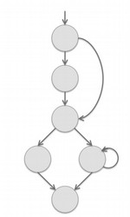
Call and control flow graphs
First, disassemble
Valid call targets become function entry points
For each function, perform a breadth-first control flow graph traversal
Once function ranges/basic blocks are identified, we get a call graph
This procedure might leave us with gaps in the text space that were not analyzed!
Functions that are never statically referenced in previously visited code
Fragments of functions never statically referenced in previously visited code
The presence of data
Alignment padding

Slide 3
Call and control flow graphs
First, disassemble
Valid call targets become function entry points
For each function, perform a breadth-first control flow graph traversal
Once function ranges/basic blocks are identified, we get a call graph
This procedure not analyzed!
A solution: dynamic analysis
- run the program multiple times,
at were
might leave us with gaps in the text space th
re never statically referenced in previously visited nctions never statically referenced in previously vis data
ing
– Functions that a
and observe the targets of indirect code
– Fragments of fu
jumps and calls
use this info to expand your graphs
ited code
– The presence of -
– Alignment padd

Slide 4
Dynamic Analysis
Program analysis technique performed at runtime
Historically, has been used for performance monitoring and software testing.
Security related behavioral analysis is all based on dynamic analysis. e.g. malware analysis
Security testing – fuzzing.
Can complement static analysis by providing missing info.

Slide 6
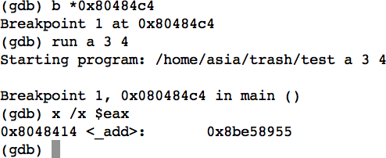
How shall we monitor call instructions at run-time?
Use gdb

Slide 7
How shall we monitor call instructions at run-time?
Use gdb to break on an instruction
Lots of manual effort!
Instrument the binary to log the targets of all indirect call/jump instructions for us
Automatically!
–

Slide 8
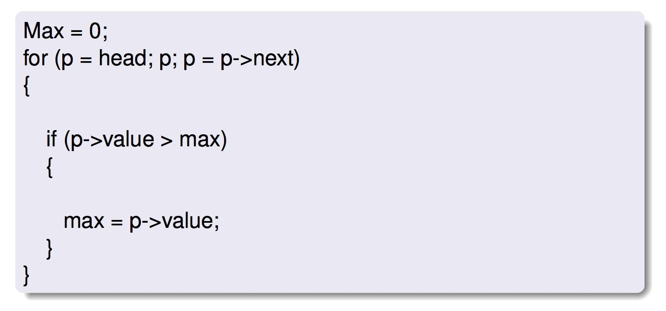
Instrumentation
A technique that injects instrumentation code into a binary to collect run-time information
It executes as a part of the normal instruction stream
It doesn’t modify the semantics of the program

Slide 9
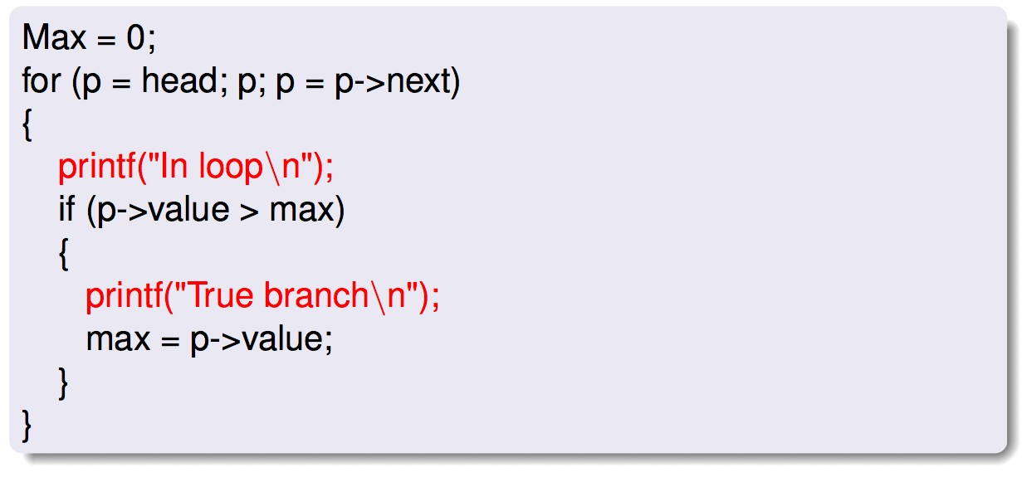
Instrumentation
A technique that injects instrumentation code into a binary to collect run-time information
It executes as a part of the normal instruction stream
It doesn’t modify the semantics of the program

Slide 10
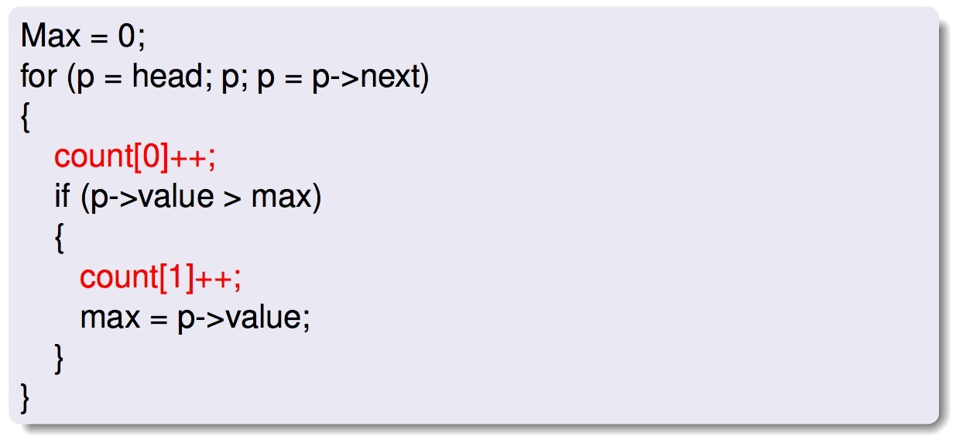
Instrumentation
A technique that injects instrumentation code into a binary to collect run-time information
It executes as a part of the normal instruction stream
It doesn’t modify the semantics of the program

Slide 11
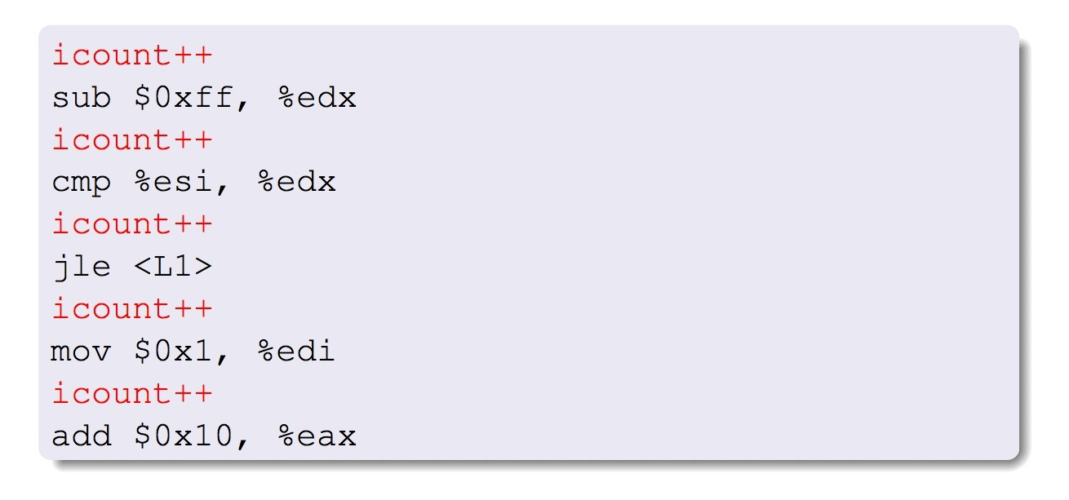
Instrumentation
A technique that injects instrumentation code into a binary to collect run-time information
It executes as a part of the normal instruction stream
It doesn’t modify the semantics of the program

Slide 12
Instrumentation
A technique that injects instrumentation code into a binary to collect run-time information
It executes as a part of the normal instruction stream
It doesn’t modify the semantics of the program

Slide 13
When is instrumentation useful?
Profiling for compiler optimization/performance profiling:
Instruction profiling
Basic block count
Value profile
Bug detection/Vulnerability identification/Exploit generation:
Find references to uninitialized, unallocated addresses
Inspect arguments at a particular function call
Inspect function pointers and return addresses
Record & replay
Architectural research: processor and cache simulation, trace collection

Slide 14
Instrumentation
Static instrumentation – instrument before runtime
Source code instrumentation
Instrument source programs (e.g., clang’s source-to-source transformation)
IR instrumentation
Instrument compiler-generated IR (e.g., LLVM)
Binary instrumentation
Instrument executables directly by inserting additional assembly instructions (e.g., Dyninst)
Dynamic binary instrumentation – instrument at runtime
Instrument code just before it runs (Just in time – JIT)
E.g., Pin, Valgrind, DynamoRIO, QEMU

Slide 15
Why binary instrumentation
Libraries are a big pain for source/IR-level instrumentation
Proprietary libraries: communication (MPI, PVM), linear algebra (NGA), database query (SQL libraries)
Easily handles multi-lingual programs
Source code level instrumentation is heavily language dependent.
Worms and viruses are rarely provided with source code

Slide 16
Dynamic binary instrumentation
Pros
No need to recompile or relink
Discovers code at runtime
Handles dynamically generated code
Attaches to running processes (some tools)
Cons
Usually higher performance overhead
Requires a framework which can be detected by malware

Slide 17

Pin
A Dynamic Binary Instrumentation Tool

Slide 18
Pin
Pin is a tool for the instrumentation of programs. It supports Linux* and Windows* executables for x86, x86_64, and IA-64 architectures.
Pin allows a tool to insert arbitrary code (written in C or C++) in arbitrary places in the executable. The code is added dynamically while the executable is running. This also makes it possible to attach Pin to an already running process.

Slide 19
What can we do with Pin?
Fully examine any (type of) x86 instruction
Insert a call to your own function which gets called when that instruction executes
Parameters: register values (including IP), memory addresses, memory contents…
Track function calls, including library calls and syscalls
Examine/change arguments
Insert function hooks: replace application/library functions with your own
Track application threads

Slide 20
Advantages of Pin
Easy-to-use Instrumentation:
Uses dynamic instrumentation
Does not need source code, recompilation, post-linking
Programmable Instrumentation:
Provides rich APIs to write in C/C++ your own instrumentation tools (called Pintools)
Multiplatform:
Supports x86, x86_64
Supports Linux, Windows binaries
Robust:
Instruments real-life applications: Database, web browsers,. . .
Instruments multithreaded applications
Supports signals
Efficient:
Applies compiler optimizations on instrumentation code

Slide 21
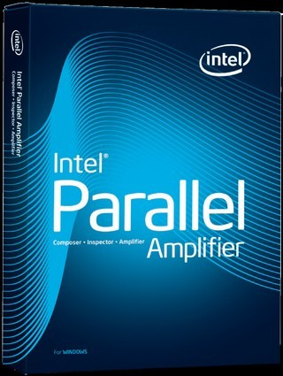

Usage of Pin at Intel
Profiling and analysis products
Intel Parallel Studio
Amplifier (Performance Analysis)
Lock and waits analysis
Concurrency analysis
Inspector (Correctness Analysis)
Threading error detection (data race and deadlock)
Memory error detection
Architectural research and enabling
Emulating new instructions (Intel SDE)
Trace generation
Branch prediction and cache modeling

Slide 22
Pin usage outside Intel
Popular and well supported
100,000+ downloads,
4226+ citations
– (as of 2019-2020)
Free DownLoad
https://software.intel.com/en-us/articles/pin-a-dynamic-binary-instrumentation- tool
Includes: Detailed user manual, source code for 100s of Pin tools
•
Pin User Group (PinHeads)
– https://groups.io/g/pinheads
– Pin users and Pin developers answer questions

Slide 23

Architecture overview

Slide 24
./pin –t pintool -- test
pintool - instrumentation routines
Pin
Virtual machine
test -
Dispatcher
Code cache
JIT compiler
E | mulation unit
unmodified code
unmo
Operating System
Hardware

Slide 25
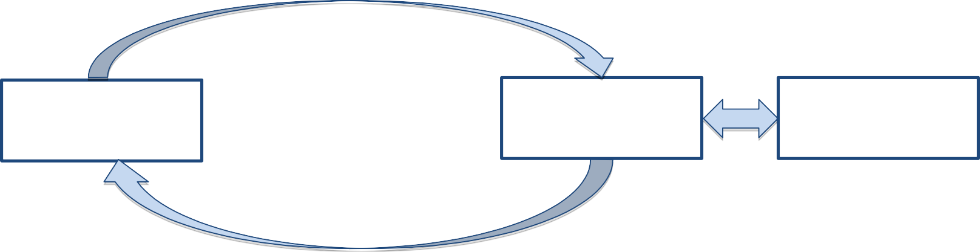
JIT compilation
JIT compiler
Dispatcher Execute
code
Unmodified code
Translated code
If instruction not yet translated

Slide 26
JIT compilation
•
•
•
insert instrumentation
short sequence of
patch jumps targets
JIT compiler
make sure that the control
•
basic blocks
returns to the JIT compiler
Dispatcher Execute
code
Unmodified code
Translated code
Cache translated code
If instruction not
yet translated

Slide 27

Example 1: docount
- instruction counting tool

Slide 28
Instruction counting tool
#include “pin.h” uint64_t icount = 0;
void docount() { icount++; }
void Instruction(INS ins, void *v) { INS_InsertCall(ins, IPOINT_BEFORE,
(AFUNPTR) docount, IARG_END);
}
void Fini(INT32 code, void *v)
{ std::cerr << “Count: ” << icount << endl; }
int main(int argc, char **argv) {
PIN_Init(argc, argv); INS_AddInstrumentFunction(Instruction, 0);
PIN_AddFiniFunction(Fini, 0);
PIN_StartProgram();
return 0;
// never returns
}

Slide 29
Instruction counting tool
#include “pin.h” uint64_t icount = 0;
void docount() { icount++; }
void Instruction(INS ins, void *v) { INS_InsertCall(ins, IPOINT_BEFORE,
(AFUNPTR) docount, IARG_END);
}
void Fini(INT32 code, void *v)
{ std::cerr << “Count: ” << icount << endl; }
Initialize PIN
int main(int argc, char **argv) {
PIN_Init(argc, argv); INS_AddInstrumentFunction(Instruction, 0);
PIN_AddFiniFunction(Fini, 0);
PIN_StartProgram();
return 0;
// never returns
}

Slide 30
Instruction counting tool
#include “pin.h”
uint64_t icount = 0;
INS is valid only
inside this routine.
void docount() { icount++; }
void Instruction(INS ins, void *v) { INS_InsertCall(ins, IPOINT_BEFORE,
(AFUNPTR) docount, IARG_END);
}
Instrumentation routine; called during jitting of INS.
void Fini(INT32 code, void *v)
{ std::cerr << “Count: ” << icount << endl; }
int main(int argc, char **argv) { PIN_Init(argc, argv);
INS_AddInstrumentFunction(Instruction, 0);
Register instruction instrumentation
PIN_AddFiniFunction(Fini, 0);
PIN_StartProgram();
return 0;
// never returns
routine
}

Slide 31
Instruction counting tool
#include “pin.h” uint64_t icount = 0;
Analysis routine; Executes each time jitted INStruction executes.
void docount() { icount++; }
void Instruction(INS ins, void *v) { INS_InsertCall(ins, IPOINT_BEFORE,
(AFUNPTR) docount, IARG_END);
}
void Fini(INT32 code, void *v)
{ std::cerr << “Count: ” << icount << endl; }
int main(int argc, char **argv) {
PIN_Init(argc, argv);
INS_AddInstrumentFunction(Instruction, 0);
PIN_AddFiniFunction(Fini, 0);
PIN_StartProgram();
return 0;
// never returns
}

Slide 32
Instruction counting tool
#include “pin.h”
uint64_t icount = 0;
Question: which function gets executed more often?
void docount() { icount++; }
void Instruction(INS ins, void *v) { INS_InsertCall(ins, IPOINT_BEFORE,
(AFUNPTR) docount, IARG_END);
}
void Fini(INT32 code, void *v)
{ std::cerr << “Count: ” << icount << endl; }
int main(int argc, char **argv) {
PIN_Init(argc, argv);
INS_AddInstrumentFunction(Instruction, 0);
PIN_AddFiniFunction(Fini, 0);
PIN_StartProgram();
return 0;
// never returns
}

Slide 33
Instruction counting tool
Translation time (JIT compilation)
Rewriting only! We don’t execute the native BB now!
Execution time (Dispatcher)
Native BB
call docount
call docount
INSTR 1
call docount
INSTR 2
call docount
INSTR 3
call docount
INSTR 4
ret to VM (Pin)
call docount
INSTR 1
INSTR 2
INSTR 3
INSTR 4
call docount
INSTR 1
INSTR 1
INSTR 1
INSTR 2
INSTR 1
call docount
call docount
INSTR 3
call docount
INSTR 2
INSTR 2
INSTR 4
INSTR 2
call docount
call docount
call docount
INSTR 3
INSTR 3
Analysis routine (docount)
INSTR 3
call docount
call docount
call docount
INSTR 4
INSTR 4
INSTR 4
ret to VM
ret to VM
(Pin)
ret to VM
CPU
Call the Instruction instrumentation routine to see that we need to insert a call to docount before every instruction.
To be precise, INSTR X are not necessarily exactly the same, but very little is changed.
CPU
Execute the translated block. During the execution, the analysis routines are executed. In our case -
docount.
59

Slide 34

Instrumentation vs Analysis
Instrumentation routines
Define where instrumentation is inserted, e.g., before instruction
Invoked when an instruction is being jitted
Analysis routines
Define what to do when instrumentation is activated, e.g., increment counter
Invoked every time an instruction is executed
60

Slide 35
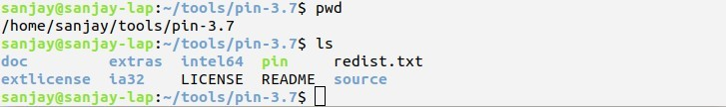
Pin execution
1. Download Pin from http://www.pintool.org
2. Write your own pintool.
Numerous examples:
sanjay@sanjay-lap:~/tools/pin-3.7/source/tools$ ls
Our instruction counting tool
make obj-intel64/inscount0.so TARGET=intel64

Slide 36
Pin execution
3. Set the PIN_HOME environment variable to your Pin directory, and make.
sanjay@sanjay-lap:~/tools/pin-3.7$ export PIN_HOME=~/tools/pin-3.7/
4. Run

Slide 37
JIT compilation
•
•
•
insert instrumentation
short sequence
patch jumps targets
of basic blocks
JIT compiler
•
make sure that the control
returns to the JIT compiler
Dispatcher Execute
code
Unmodified code
Translated code
Cache translated code
If instruction not
yet translated

Slide 38
Trace
The application is compiled one trace at a time
A sequence of basic blocks with one entry point
It terminates at one of the conditions:
an unconditional control transfer, i.e., jmp/call/ret
a pre-defined number of conditional control transfers
a pre-defined number of instructions
Always ends with a stub which redirects control back to the VM

Slide 39
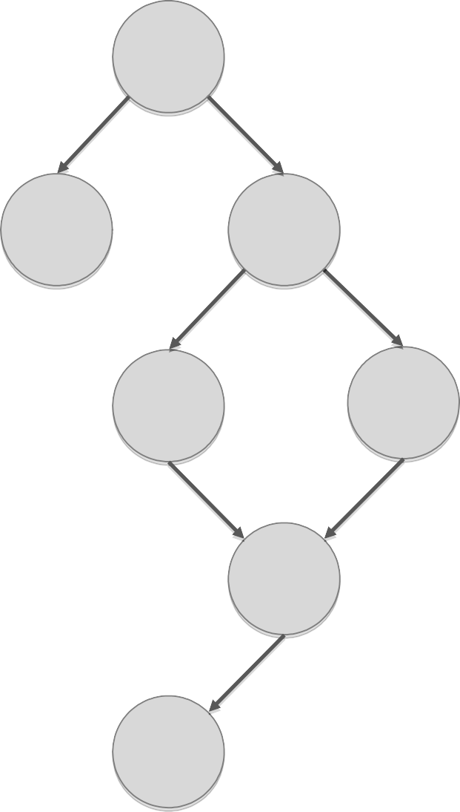
Trace
Original code
BB 1
BB 2
BB 3
BB 4
BB 5
BB 6
BB 7

Slide 40
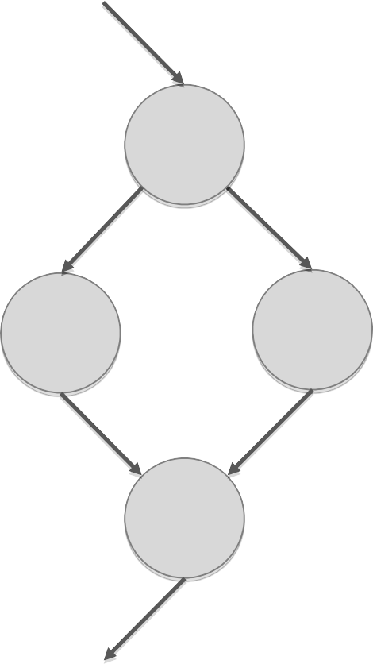
Trace
Original code
BB 1
BB 2
BB 3
BB 4
BB 5
BB 6
BB 7

Slide 41
Trace
Translated trace
Original code
BB 1
^{BB 1} Early exit via stub
BB 2
BB 3
^{BB 2} Early exit via stub
BB 5
BB 7
BB 4
Trace exit via stub
BB 6
BB 7

Slide 42
Counting at the BBL/Trace level
Counting at BBL level
Counting at Trace level
counter += 3
sub $0xff, %edx
cmp %esi, %edx
jle <L1>
sub $0xff, %edx cmp %esi, %edx
jle <L1>
counter += 2 mov $0x1, %edi
add $0x10, %eax
counter+=3
mov $0x1, %edi
add $0x10, %eax
counter += 5
L1

Slide 43
Example 3: Malloc wrapping
43

Slide 44
Malloc tracing tool
#include “pin.h”
void mallocBefore(ADDRINT size){ printf(“malloc(%d)\n”, size); }
void mallocAfter(ADDRINT ret){ printf(“\tmalloc returns 0x%x\n”, ret); }
void Image(IMG img, void *v) { // jitting time routine RTN mallocRtn = RTN_FindByName(img, “malloc”);
if (RTN_Valid(mallocRtn) {
RTN_Open(mallocRtn);
RTN_InsertCall(mallocRtn, IPOINT_BEFORE, (AFUNPTR)mallocBefore, IARG_FUNCARG_ENTRYPOINT_VALUE, 0, IARG_END);
RTN_InsertCall(mallocRtn, IPOINT_AFTER, (AFUNPTR)mallocAfter, IARG_FUNCARG_EXITPOINT_VALUE, IARG_END);
RTN_Close(mallocRtn);
} }
int main(int argc, char **argv) {
PIN_InitSymbols(); PIN_Init(argc, argv);
IMG_AddInstrumentFunction(Image, 0);
PIN_StartProgram();
return 0;
// never returns
}
44

Slide 45
Malloc tracing tool
#include “pin.h”
void mallocBefore(ADDRINT size){ printf(“malloc(%d)\n”, size); }
void mallocAfter(ADDRINT ret){ printf(“\tmalloc returns 0x%x\n”, ret); }
void Image(IMG img, void *v) { // jitting time routine RTN mallocRtn = RTN_FindByName(img, “malloc”);
if (RTN_Valid(mallocRtn) {
RTN_Open(mallocRtn);
RTN_InsertCall(mallocRtn, IPOINT_BEFORE, (AFUNPTR)mallocBefore, IARG_FUNCARG_ENTRYPOINT_VALUE, 0, IARG_END);
RTN_InsertCall(mallocRtn, IPOINT_AFTER, (AFUNPTR)mallocAfter, IARG_FUNCARG_EXITPOINT_VALUE, IARG_END);
RTN_Close(mallocRtn);
} }
int main(int argc, char **argv) {
Instruct Pin to make use of any symbols which are available for this process.
PIN_InitSymbols();
PIN_Init(argc, argv); IMG_AddInstrumentFunction(Image, 0); PIN_StartProgram(); // never returns return 0;
}
45

Slide 46
Malloc tracing tool
#include “pin.h”
void mallocBefore(ADDRINT size){ printf(“malloc(%d)\n”, size); }
void mallocAfter(ADDRINT ret){ printf(“\tmalloc returns 0x%x\n”, ret); }
void Image(IMG img, void *v) { // jitting time routine RTN mallocRtn = RTN_FindByName(img, “malloc”);
if (RTN_Valid(mallocRtn) {
RTN_Open(mallocRtn);
RTN_InsertCall(mallocRtn, IPOINT_BEFORE, (AFUNPTR)mallocBefore, IARG_FUNCARG_ENTRYPOINT_VALUE, 0, IARG_END);
RTN_InsertCall(mallocRtn, IPOINT_AFTER, (AFUNPTR)mallocAfter, IARG_FUNCARG_EXITPOINT_VALUE, IARG_END);
RTN_Close(mallocRtn);
} }
int main(int argc, char **argv) { PIN_InitSymbols();
PIN_Init(argc, argv);
Direct Pin to call Image whenever an image is loaded, it can be a library or
IMG_AddInstrumentFunction(Image, 0); PIN_StartProgram(); // never returns return 0;
}
the main exec file.
46

Slide 47
Malloc tracing tool
A handle to the image being loaded
#include “pin.h”
void mallocBefore(ADDRINT size){ printf(“malloc(%d)\n”, size); }
void mallocAfter(ADDRINT ret){ printf(“\tmalloc returns 0x%x\n”, ret); }
void Image(IMG img, void *v) { // jitting time routine RTN mallocRtn = RTN_FindByName(img, “malloc”);
if (RTN_Valid(mallocRtn) {
RTN_Open(mallocRtn);
RTN_InsertCall(mallocRtn, IPOINT_BEFORE, (AFUNPTR)mallocBefore, IARG_FUNCARG_ENTRYPOINT_VALUE, 0, IARG_END);
RTN_InsertCall(mallocRtn, IPOINT_AFTER, (AFUNPTR)mallocAfter, IARG_FUNCARG_EXITPOINT_VALUE, IARG_END);
RTN_Close(mallocRtn);
} }
int main(int argc, char **argv) {
PIN_InitSymbols(); PIN_Init(argc, argv);
IMG_AddInstrumentFunction(Image, 0);
Instrumentation
routine.
PIN_StartProgram();
return 0;
// never returns
}
47

Slide 48
Malloc tracing tool
Analysis routine
#include “pin.h”
void mallocBefore(ADDRINT size){ printf(“malloc(%d)\n”, size); }
void mallocAfter(ADDRINT ret){ printf(“\tmalloc returns 0x%x\n”, ret); }
void Image(IMG img, void *v) { // jitting time routine
RTN mallocRtn = RTN_FindByName(img, “malloc”); if (RTN_Valid(mallocRtn) {
RTN_Open(mallocRtn);
RTN_InsertCall(mallocRtn, IPOINT_BEFORE, (AFUNPTR)mallocBefore, IARG_FUNCARG_ENTRYPOINT_VALUE, 0, IARG_END);
RTN_InsertCall(mallocRtn, IPOINT_AFTER, (AFUNPTR)mallocAfter, IARG_FUNCARG_EXITPOINT_VALUE, IARG_END);
RTN_Close(mallocRtn);
} }
int main(int argc, char **argv) {
PIN_InitSymbols(); PIN_Init(argc, argv);
IMG_AddInstrumentFunction(Image, 0);
Instrumentation
routine.
PIN_StartProgram();
return 0;
// never returns
}
48

